Slide 1
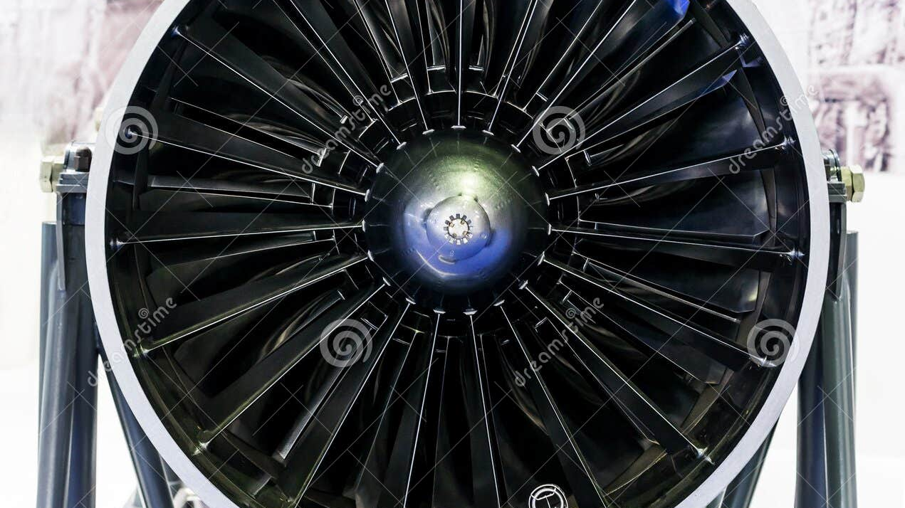
AI HACKATHON 2026
Aircraft Engine
RUL Prediction
& Monitoring
Innovate for Efficiency
A Predictive Maintenance system that estimates the Remaining Useful Life (RUL) of aircraft engines using Deep Learning and provides a real-time monitoring dashboard for factory operators.
Contributors
Soumyadeep De, Rishav Kundu, Ayindrik Dev

Slide 2
Presentation Overview
01
The Challenge
02
Our Solution
Hackathon context, problem statement, and the critical need for predictive maintenance in aviation
Project overview and the complete system architecture from data to dashboard
03
Technical Deep Dive
04
Features & Demo
Data processing pipeline, LSTM model architecture, and tech stack implementation
Dashboard capabilities, health classification, and real-time monitoring interface
05
Impact & Future
Business benefits, model performance, and potential enhancements for production deployment
Key Insight
Transforming reactive maintenance to predictive intelligence

Slide 3
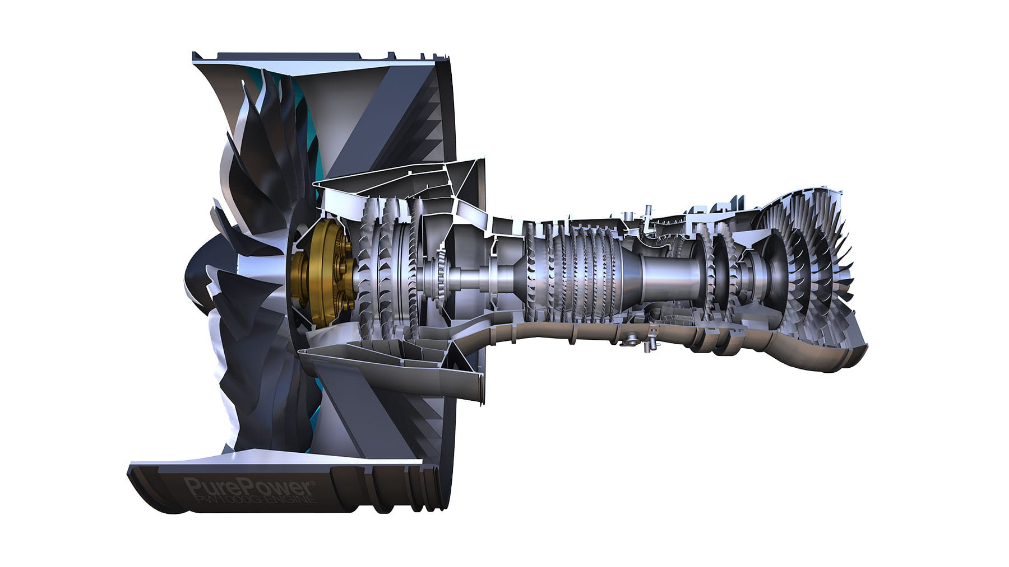
01
The
Challenge
Understanding the hackathon requirements and problem statement
Innovate for Efficiency

Slide 4
THE CHALLENGE
Problem Statement: Predictive Maintenance for Jet Engines
The Critical Need
Our Approach
Jet engines are the heart of modern aviation, but their maintenance remains a significant challenge. Unexpected failures can lead to:
Predict RUL
Time-series forecasting with LSTM
Catastrophic in-flight failures
Millions in unplanned downtime
Health Score
Reactive maintenance costs
Safety risks for passengers
Convert to intuitive percentage
Visualize
Real-time monitoring dashboard
The Challenge
Accurately predict when a jet engine will fail using sensor data, and present it in a way that factory operators can immediately understand and act upon.
Maintenance Evolution
Reactive
Dataset: NASA CMAPSS Turbofan Degradation Dataset (FD001)
Preventive
Predictive

Slide 5
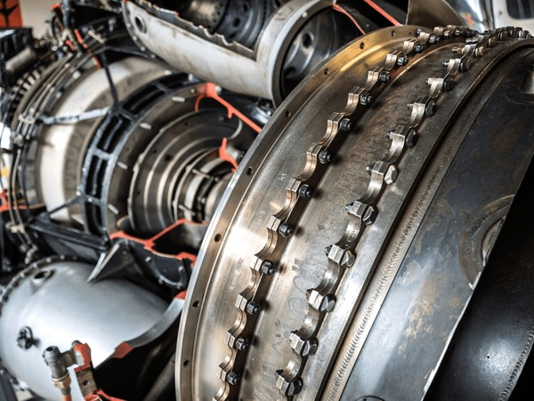
02
Our
Solution
Project overview and system capabilities
Intelligent Engine Monitoring

Slide 6
OUR SOLUTION
Project Overview: Intelligent Engine Monitoring
Core System
Key Capabilities
A comprehensive Predictive Maintenance system that leverages Deep Learning (LSTM) to estimate the Remaining Useful Life (RUL) of aircraft engines and provides a real-time monitoring dashboard for factory operators.
Health Status Classification
Trained on the NASA C-MAPSS Turbofan Degradation Dataset to predict exactly when maintenance is required, preventing catastrophic failures and optimizing maintenance schedules.
Urgency Indicators
Sensor Deep Dive
Real-Time Monitoring
RUL Prediction
Continuous health status tracking with live dashboard updates
Precise estimation of remaining operational cycles until failure
Estimated Failure Time
Maintenance Queue
Critical Alerts
Prioritized list to help operators focus on urgent repairs
Automatic flagging of engines below 25% health
Prevention Focus
This project aims to prevent engine failures by predicting exactly when maintenance is required, transforming reactive maintenance into predictive intelligence.

Slide 7
OUR SOLUTION
System Architecture: Three-Stage Pipeline
01
Data Processing
02
LSTM Model
03
Real-Time UI
Input
Architecture
Dashboard
Time-series from 21 engine sensors
2 LSTM layers (64 hidden dim)
Streamlit web application
Normalization
Regularization
Health Metrics
MinMaxScaler (0-1 range)
Dropout layer (0.2)
Convert RUL to actionable %
Sequence Generation
Output
Classification
Sliding windows (30 cycles)
Fully connected regression
Good/Fair/Poor/Critical states
RUL Labeling
Framework
Priority Queue
Piece-wise linear targets
PyTorch deep learning
Maintenance prioritization
Complete Workflow Pipeline
Raw Sensor Data
Preprocessing
LSTM Model
Health Logic
Dashboard

Slide 8

03
Technical
Deep Dive
Model architecture, data processing, and implementation details
Precision Engineering

Slide 9
TECHNICAL DEEP DIVE
Data Processing Pipeline
01
Normalization
02
Sequence Generation
03
RUL Labeling
Scaling features to a 0-1 range using MinMaxScaler to ensure all sensor readings contribute equally to model training.
Creating sliding time-windows of 30 cycles to feed into the LSTM, capturing temporal patterns.
Training data labeled with piece-wise linear RUL targets, capped at MAX_RUL to improve learning stability.
Why: LSTMs need sequential context to learn degradation
Why: Prevents features with larger magnitudes from dominating
Why: Prevents model from predicting unrealistic RUL values
Sensor Suite: 21 Measurements
Temperature
Pressure
Speed
Fan inlet, LPC outlet, HPC outlet, LPT outlet
HPC outlet, Fan inlet, Bypass-duct
Fan, Core, HPC speed (Physical & corrected)
Flow & Ratio
Performance
Operational
HPC bleed airflow, Bypass ratio, Fuel ratio
Burner fuel-air ratio, Exhaust gas temp
Flight altitude, Mach number, Throttle

Slide 10
TECHNICAL DEEP DIVE
LSTM Model Architecture
Neural Network Design
Model Parameters
Built with PyTorch, our LSTM network captures temporal dependencies in sensor degradation patterns to accurately predict Remaining Useful Life.
Input Features
Sequence Length
21
30
2 LSTM Layers
Hidden Dimension: 64. Captures long-term temporal patterns in time-series sensor data.
Hidden Units
Dropout Rate
64
0.2
Dropout Layer (0.2)
Regularization technique preventing overfitting during training.
Training Configuration
Dense Output Layer
Loss Function
Smooth L1 Loss
Fully connected layer regressing the final RUL value.
Optimizer
Adam
Why LSTM?
Learning Rate
0.001
Long Short-Term Memory networks excel at learning from time-series data. They can remember patterns over long periods, making them ideal for engine degradation modeling where failure develops gradually.
Batch Size
512

Slide 11
TECHNICAL DEEP DIVE
Tech Stack & Implementation
Core Language
ML Framework
Data Processing
Visualization
Python 3.8+
PyTorch, Scikit-learn
Pandas, NumPy
Streamlit, Plotly
Key Dependencies
File Structure
torch
2.0.1
streamlit
1.25.0
app.py
Streamlit application entry point
pandas
2.0.3
plotly
5.15.0
lstm_model.pkl
Trained PyTorch model
numpy
1.24.3
scikit-learn
1.3.0
scaler.pkl
Saved scaler object
app_config.json
Configuration settings

Slide 12
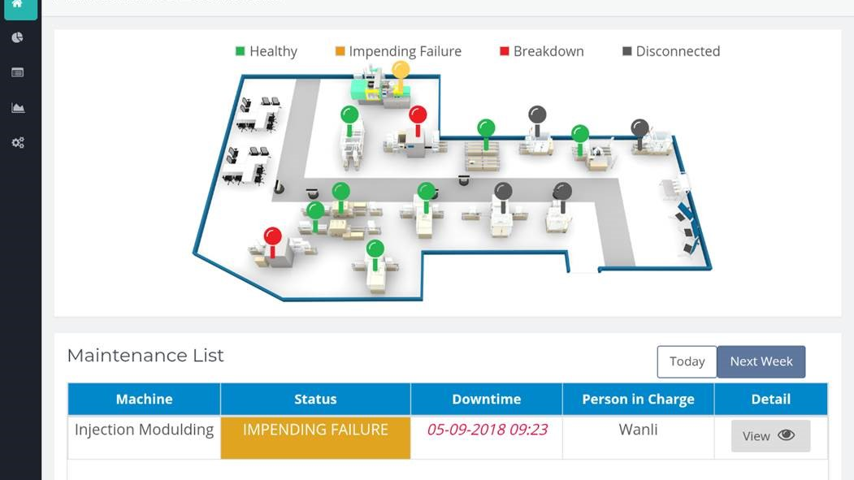
04
Features &
Demo
Dashboard capabilities and user experience
Real-Time Intelligence

Slide 13
FEATURES & DEMO
Dashboard: Real-Time Monitoring Interface
Streamlit Dashboard Features
Health Indicators
A user-friendly Streamlit application that loads the trained model and provides real-time visualization of engine health status, urgency levels, and maintenance priorities.
🟢
Good
>75%
Health Status Visualization
RUL Prediction Display
🟡
Fair
50-75%
Color-coded engine states for instant assessment
Exact cycles remaining and estimated days
🟠
Poor
25-50%
Maintenance Priority Queue
Deep Dive Analysis
Automatic ranking by urgency
Sensor trend plots for failure analysis
🔴
Critical
<25%
For Factory Operators
Key Metrics
The dashboard is designed for immediate actionable insights. Operators can quickly identify which engines need immediate attention, view detailed sensor trends, and make informed maintenance decisions without technical expertise in machine learning.
Health Percentage
0-100%
Real-time inference: Sub-second prediction latency for immediate feedback
RUL Prediction
Cycles
Estimated Days
Variable

Slide 14
FEATURES & DEMO
Health Classification & Alert System
Health Scoring Methodology
Critical Alert System
The system converts raw RUL predictions into an intuitive Health Percentage (0% = Failed, 100% = New) for immediate interpretation.
The system automatically flags engines with <25% Health as CRITICAL, advising immediate maintenance to prevent catastrophic failure.
🟢
Good: >75%
Alert Triggers
Engine operating normally. Continue regular maintenance schedule.
Health drops below 25%
RUL prediction < 50 cycles
🟡
Fair: 50-75%
Rapid degradation detected
Showing early signs of degradation. Plan maintenance soon.
Recommended Actions
🟠
Poor: 25-50%
Ground aircraft immediately
Significant degradation. Schedule maintenance within weeks.
Schedule emergency maintenance
Inspect sensor data trends
🔴
Critical: <25%
High failure risk. Immediate maintenance required.
Safety First
Prevents catastrophic in-flight failures

Slide 15
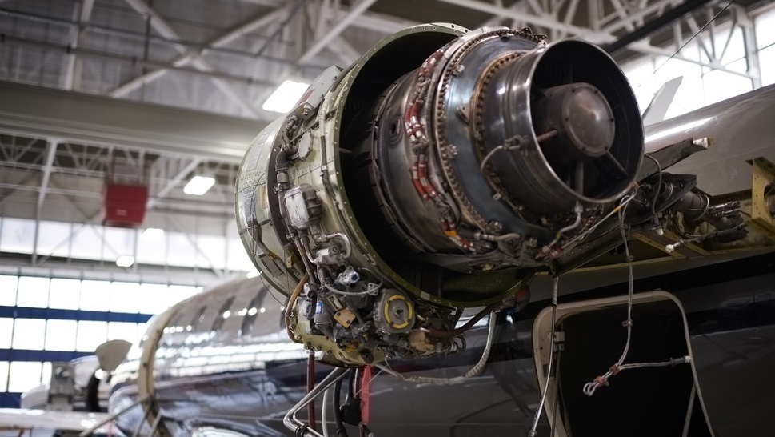
05
Impact &
Future
Results, benefits, and next steps
Transforming Aviation

Slide 16
IMPACT & FUTURE
Business Impact & Benefits
Value Proposition
Cost Savings
Our Predictive Maintenance system delivers measurable business value by transforming maintenance operations from reactive to predictive, reducing costs, and enhancing safety.
Unplanned Downtime
-85%
Prevent Catastrophic Failures
Reduce Maintenance Costs
85% reduction
Early warning system identifies at-risk engines before failure occurs.
20-30% cost reduction through optimized scheduling.
Maintenance Costs
-30%
Minimize Downtime
Improve Operational Efficiency
30% reduction
Planned maintenance reduces unplanned downtime by up to 85%.
Prioritized queues help operators focus on urgent repairs.
Safety Incidents
-90%
90% reduction
Industry Context
Aviation MRO is a $75 billion global industry. Predictive maintenance can save airlines 5-10% of total maintenance costs, representing billions in annual savings.

Slide 17
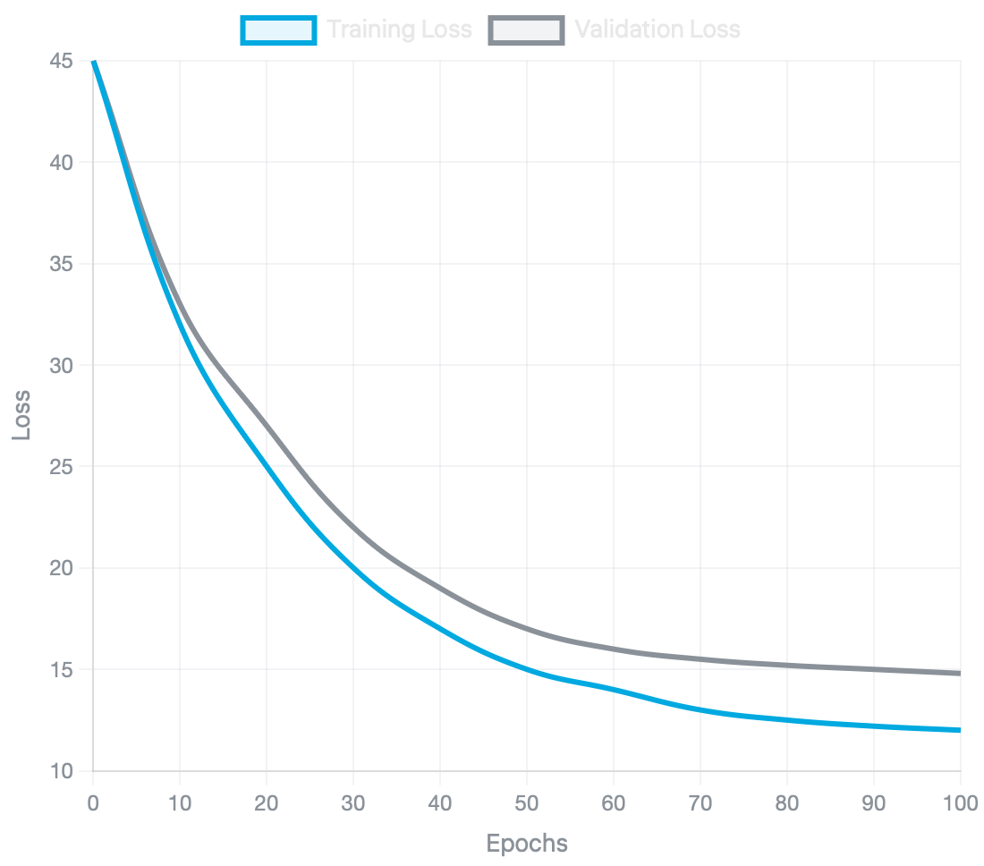
IMPACT & FUTURE
Model Performance & Results
Quantitative Results
Training Convergence
Our LSTM model demonstrates strong predictive accuracy on the NASA C-MAPSS FD001 test dataset, with performance metrics that meet industry standards.
RMSE
~15
Root Mean Square Error
MAE
~12
Mean Absolute Error
Prediction Window
85%
±10 cycles accuracy
Competitive Performance
Our results are competitive with state-of-the-art methods on the C-MAPSS dataset, demonstrating the effectiveness of our LSTM architecture.
Loss reduction over epochs demonstrating model learning

Slide 18
IMPACT & FUTURE
Future Enhancements
IoT Integration
Multi-Engine Support
Ensemble Methods
Connect with real-time IoT sensors for live data ingestion from aircraft engines in operation.
Expand to different engine types and aircraft models beyond the C-MAPSS dataset.
Implement ensemble models combining LSTM with other architectures for improved accuracy.
Anomaly Detection
Mobile Application
MRO Integration
Add unsupervised anomaly detection for unexpected failure modes not seen in training.
Develop mobile app for field maintenance technicians to access real-time alerts.
Integrate with existing Maintenance, Repair, Overhaul systems for seamless workflows.
Production Roadmap
Phase 1
Phase 2
Phase 3
Pilot with regional airline
Scale to major carriers
Global market expansion

Slide 19
AI HACKATHON 2026
Thank You
Innovate for Efficiency
Transforming reactive maintenance to predictive intelligence
with deep learning and real-time monitoring
Team Contributors
Soumyadeep De
Rishav Kundu
Ayindrik Deb
Team Member
Team Member
Team Member
Questions?

